Slide 1
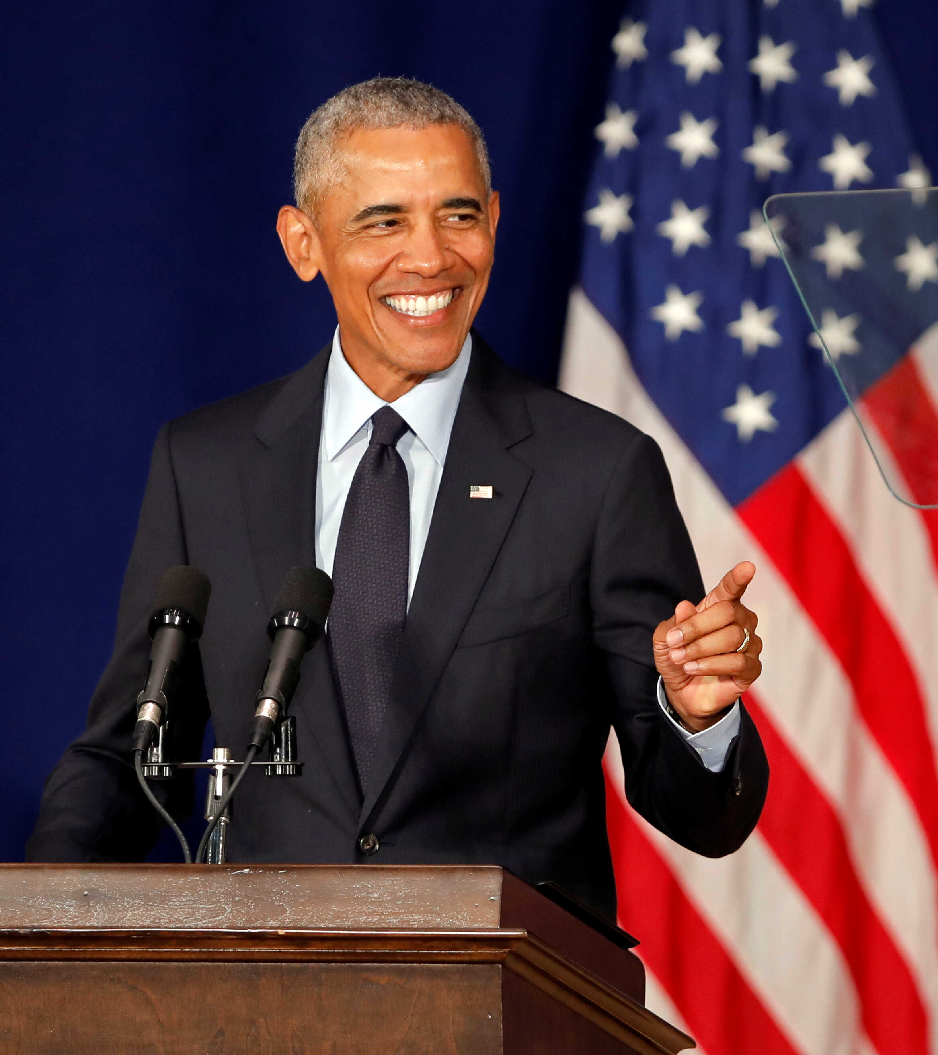
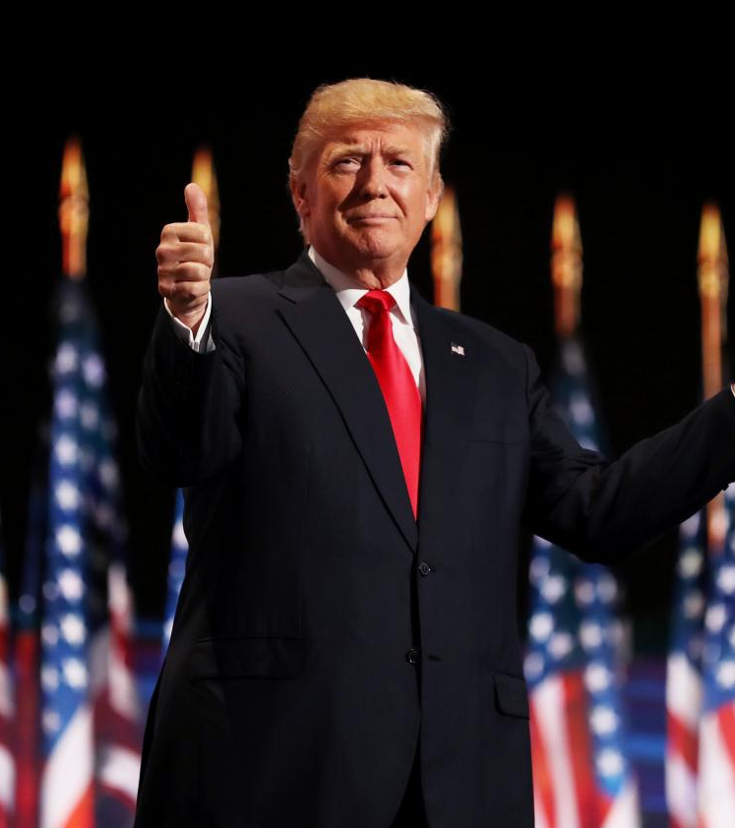
Elections Data mining

Slide 2

Our project title

Slide 3

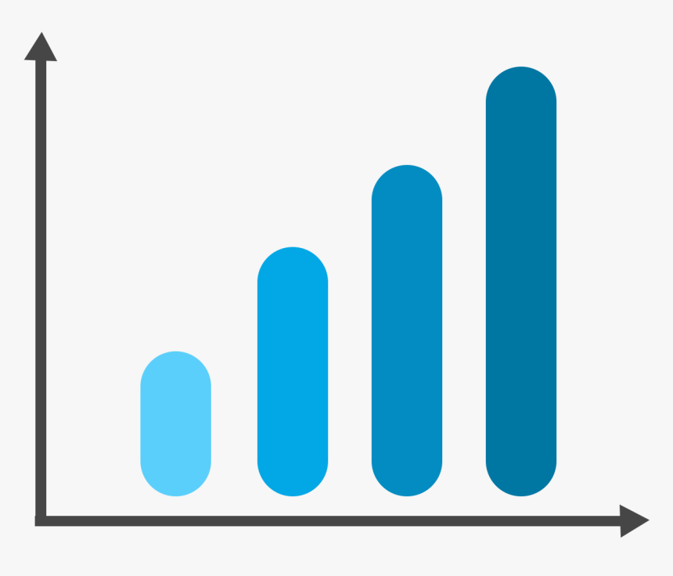
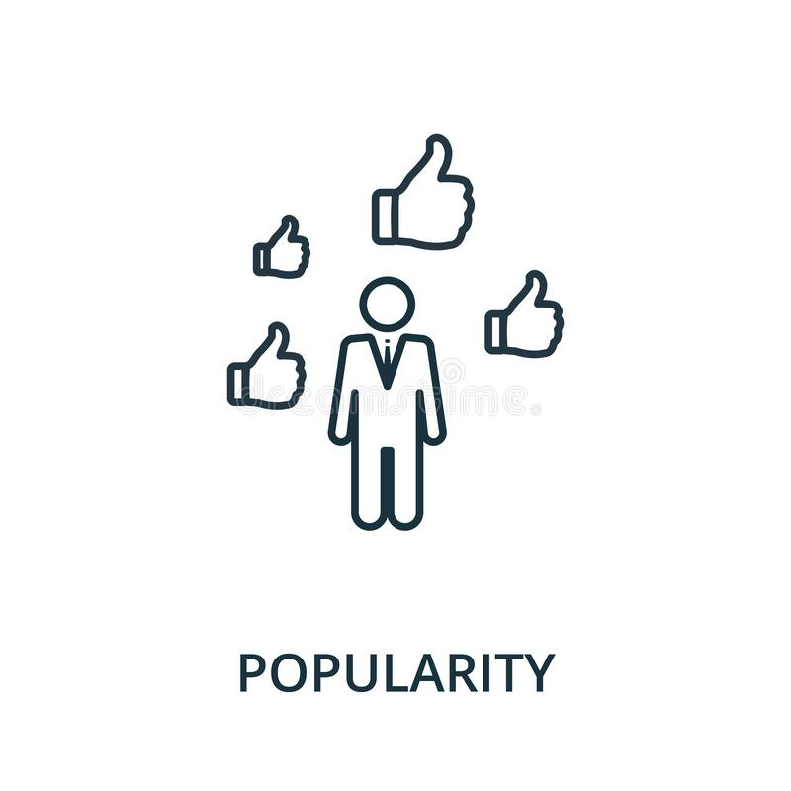



Slide 4
A Method for Predicting the Winner of the USA Presidential Elections using Data extracted from Twitter
By: Lazaros Oikonomou and Christos Tjortjis

Slide 5
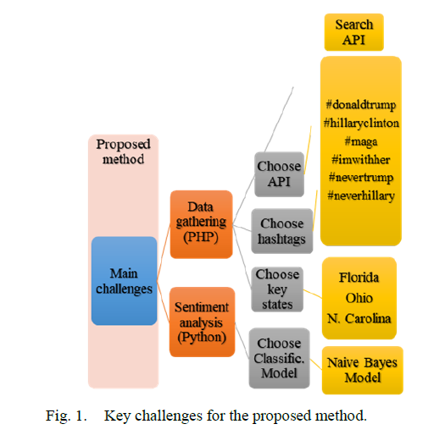
Key challenges for proposed methods

Slide 6
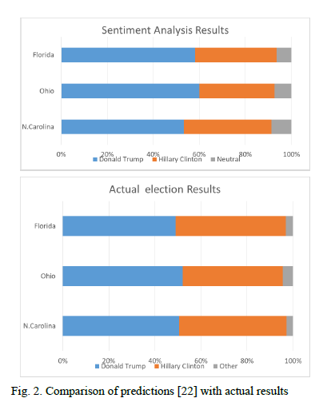
comparison

Slide 7
Social media and microtargeting: Political data processing and the consequences for Germany
By: Orestis Papakyriakopoulos , Simon Hegelich,
Morteza Shahrezaye and Juan Carlos Medina Serrano

Slide 8

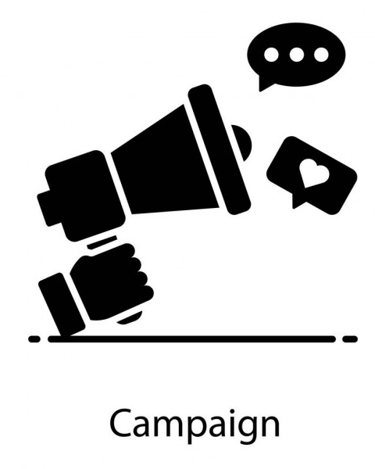
Microtargeting

Slide 9


Barriers
Privacy and data protection
policy
Data bias

Slide 10
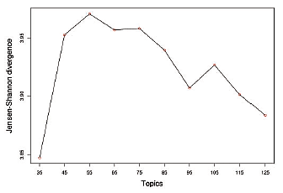
Data Gathering
Latent Dirichlet Allocation
Adjust the campaign

Slide 11
Contribution - overview
We propose a 3-stage framework:
data acquisition (From Twitter Search API - snscrape).
Feature engineering and semi-supervised learning.
Compute insights & Analysis.
Notes:
Now as to our contribution we introduce a novel 3 stage framework for outputting the required analysis.
First, we begin by acquiring Twitter Tweets using Twitter search API, then we prepare for the semi-supervised learning stage by labelling part of the data as we will see later.
In the second stage, we apply feature engineering on the Tweets and apply semi-supervised learning in order to come up with a model with the sole purpose of classifying whether a sentence is relevant to the election or not as we will see later in the presentation.
It goes without mentioning that this stage is very viable in its own as we can generalize the models produced to other social media platforms to filter out any posts that are irrelevant to the elections.
Lastly, we apply sentiment analysis and other algorithms to induce important insights for the candidates.

Slide 12
Data Acquisition
Use snscrape to query for all tweets within a geographical region of interest and the wanted time window.
Extract a sample of the tweets and label them as:
Talking about Candidate 1
Talking about Candidate 2
Talking about both candidates.
Talking about neither. (not related to elections)
Notes:
Now, as for the Data Acquisition stage, using a python package called snscrape which is built upon many famous social media APIs including Twitter Search API, we will query for all tweets belonging to the country of interest and in the time period of the elections.
Then, In preparation for the semi supervised learning stage: we will label only a sample of the tweets according to four categories according to the main subject.

Slide 13
Two methods for labeling Tweets
Manual labeling through human annotators.
Automatic labeling using hashtags or any related words.

Slide 14
Use case Hashtags
#Hashtag | Frequency
#trump | 1075255
#biden | 693449
#joebiden | 355880
#election2020 | 181822
#donaldtrump | 176404
#elections2020 | 104614
#bidenharris2020 | 80961
We can create a deterministic relation between the hashtags and the tweet category.
Notes:
For example, these were the most frequent hashtags during USA 2020 elections period, we can create a deterministic relation between the tweet category and a set of predetermined hashtags, so if a tweet contains the hashtag Trump or DonaldTrump then it is probably talking about Trump, if it has Biden then it is talking about Biden and so forth and if it has both hashtags or only contains the hashtag elections then it is probably talking about both of them.

Slide 15
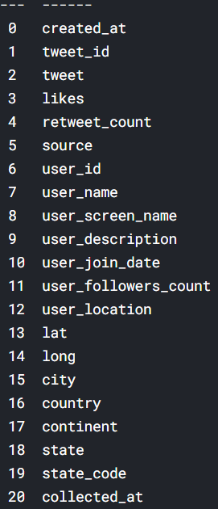
Cleansing and preparation
Our aim is to obtain the data from specific country
remove fake accounts
removed tweet's location outside of the USA
Include only tweets that are dated within or near the election period
excluded accounts with zero followers count and tweets from users that have their twitter join date around the time of election.
dropped columns that do not provide useful insights like tweet id, user id, username, user screen name, user description, User join date , collected at

Slide 16
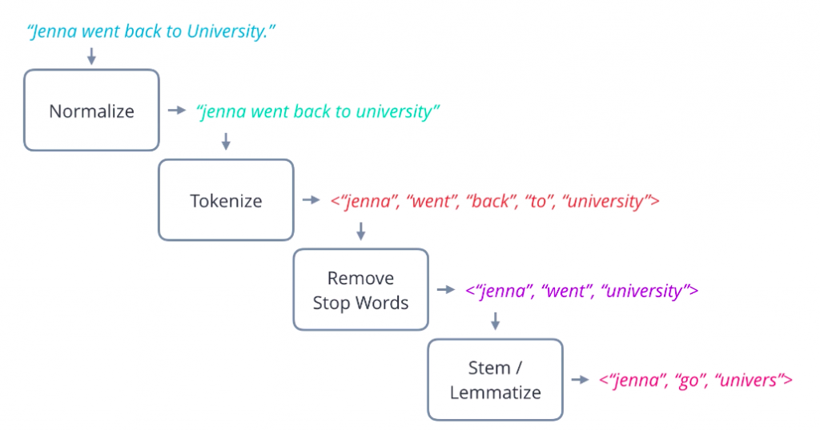

Slide 17
Semi-supervised Machine learning
Few of the tweets will be labeled using human annotators that will be responsible for creating 3 datasets.
One for tweets related to Biden
one for tweets related to Trump
one for tweets related to both
others will be discarded
Train multiclass classification model using the annotated data to predict the rest of the labels according to converge criteria
Repeat training the model using the whole dataset to get more prediction that will be training data set for the new model
To reduce the amount of data we can use also # Hashtags as filtering criteria as it is offered by twitter.

Slide 18
XGBOOST and Voting Classifier
Random Forest, XGBOOST and Ada-boost will be used
majority classifier hard voting will be performed to get the best model for classification.
Similar labels will be given to new data set to have total of 3 datasets that will be used for analysis and insights
Data labeled with both Biden and Trump will added to both dataset

Slide 19
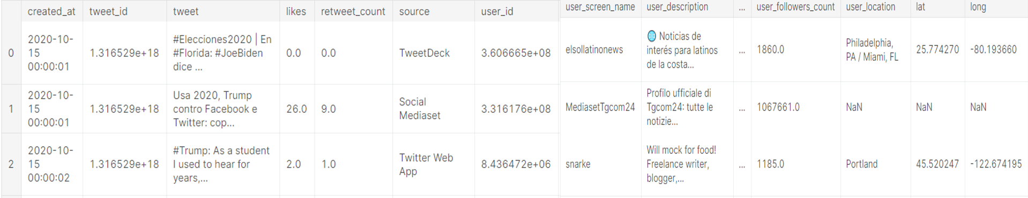
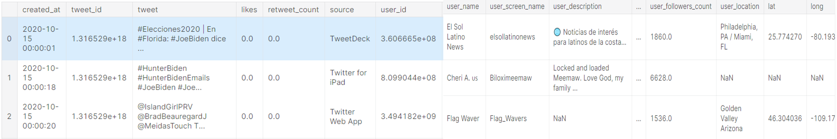
Trump Dataset
Biden Dataset

Slide 20
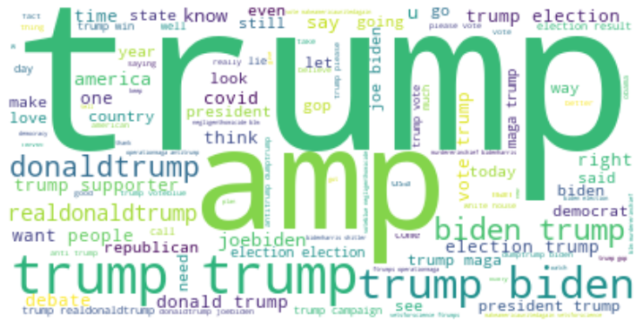
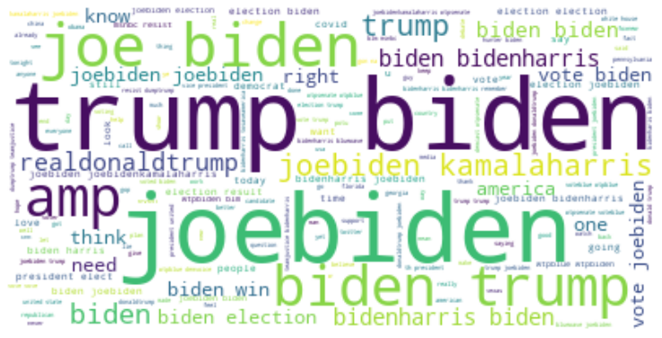
Trump Dataset
Biden Dataset

Slide 21
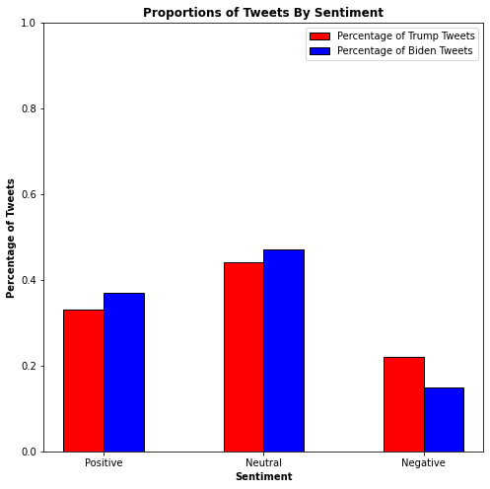
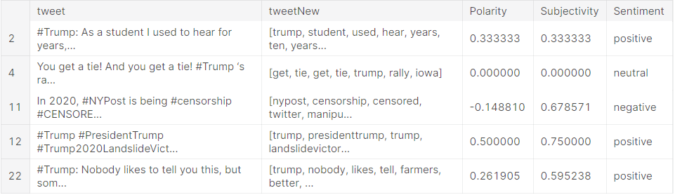
Sentiment Analysis
We are trying to get the over all sentiment analysis for each state whether its is positive, neutral or negative. so, we apply sentiment analysis model for the 3 datasets.

Slide 22
